Slide 1
AI Answer Sheet Validation

Slide 2

Meet The Team
AI Answer Sheet Validation

Slide 3

Problem Statement
Manually evaluating answer sheets is time-consuming and challenging for teachers, especially with illegible handwriting and large class sizes.
Manual grading also risks an unintentional biases, making the process less consistent.

Slide 4
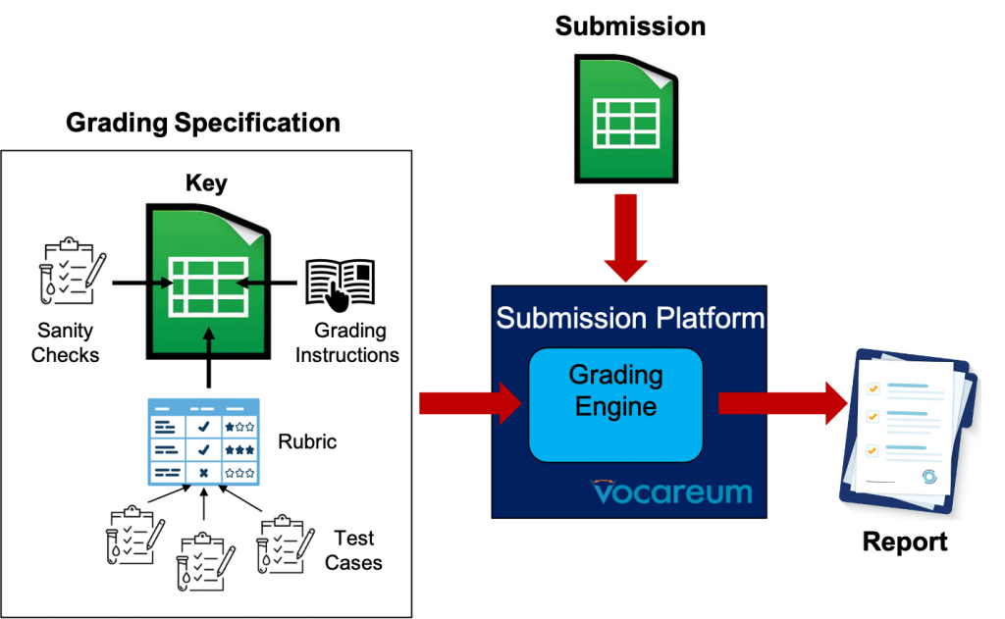

Solution
A robust OCR and assessment system will process student responses from scanned images and PDFs and automatically evaluate it using a marking scheme.
This will ensuring fair, efficient, and timely grading for all students.
It would also help reduce the workload on teachers and improve consistency in evaluations.

Slide 5
Product Architecture
A High-Level Overview
User Interface
Backend
ML Model

Slide 6
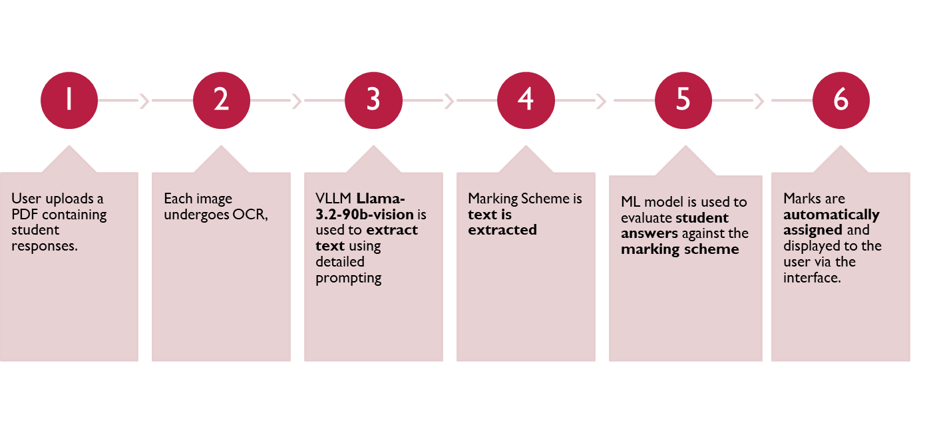
How It Works

Slide 7



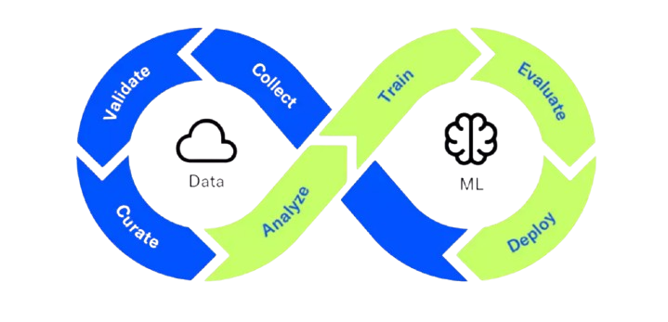




MLOps Lifecycle
Data Collection
•Student handwritten responses
•Marking Scheme
Data Preprocessing
• Image Enhancement
•OCR Text Extraction
•One-Shot Inference
•Infer marks and feedback using a prompt.
•Output structured scores
Continuous Improvement
•Update prompts and models
Model Validation
•Accuracy
•Runtime performance
Monitoring and Feedback
•Continuous monitoring of Error rates in OCR
•Collect user feedback for refinement.
Deployment
•Deploy the one-shot inference pipeline on a cloud platform

Slide 8
DEMO

